Slide 1

Predictive Analysis on Road Accident Risks Based on Heterogeneous Sparse Data
Predictive Analysis on Road Accident Based on Heterogeneous Sparse Data
Debayan Das(19MCA0070)
Madhurima Chakraborty(19MCA0087)
Pragya Yadav(19MCA0125)
Master of Computer Application
Vellore Institute of Technology, Vellore

Slide 2
Predictive Analysis on Road Accident Based on Heterogeneous Sparse Data
Problem Statement:
The problem discussed here focusses on the prediction of road accident based on factors like weather condition, location, time at which the accident had occurred, etc. We have aimed to locate the areas prone to accidents, according to the real-time dataset and categorize the accidents based on it’s severity , using supervised learning.
This would help us in predicting the accidents so as to take precautions for the same.

Slide 3
Predictive Analysis on Road Accident Based on Heterogeneous Sparse Data
Dataset:
This is a countrywide traffic accident dataset, which covers 49 states of the United States. The data is collected from February 2016 to December 2019, using several data providers, including two APIs which provide streaming traffic event data. These APIs broadcast traffic events captured by a variety of entities, such as the US and state departments of transportation, law enforcement agencies, traffic cameras, and traffic sensors within the road-networks. Currently, there are about 3.0 million accident records in this dataset.
This dataset is obtained from Kaggle open public datasets:
https://www.kaggle.com/sobhanmoosavi/us-accidents

Slide 4
Predictive Analysis on Road Accident Based on Heterogeneous Sparse Data
In total the dataset Contains 49 Attributes named:
'ID', 'Source', 'TMC', 'Severity', 'Start_Time', 'End_Time', 'Start_Lat', 'Start_Lng', 'End_Lat', 'End_Lng', 'Distance(mi)', 'Description', 'Number', 'Street', 'Side', 'City', 'County', 'State', 'Zipcode', 'Country', 'Timezone', 'Airport_Code', 'Weather_Timestamp', 'Temperature(F)', 'Wind_Chill(F)', 'Humidity(%)', 'Pressure(in)’, 'Visibility(mi)', 'Wind_Direction', 'Wind_Speed(mph)', 'Precipitation(in)’, 'Weather_Condition', 'Amenity', 'Bump', 'Crossing', 'Give_Way', 'Junction', 'No_Exit', 'Railway', 'Roundabout', 'Station', 'Stop', 'Traffic_Calming', 'Traffic_Signal', 'Turning_Loop', 'Sunrise_Sunset', 'Civil_Twilight', 'Nautical_Twilight', 'Astronomical_Twilight’.

Slide 5
Predictive Analysis on Road Accident Based on Heterogeneous Sparse Data
The attributes contains descriptions about the following topics:
Location of the accident: The location of the accident i.e. the street, city, state, country moreover the geographical location(latitude & longitude) of the accident.
Weather Conditions: The various weather conditions at the time of the accident.
Time of the Occurrence of the accident: The time of the accident.
Location Description: The description of the location i.e. the nearby points of the accident location.
Severity: The severity of the accident i.e. how much sever the accident was.

Slide 6
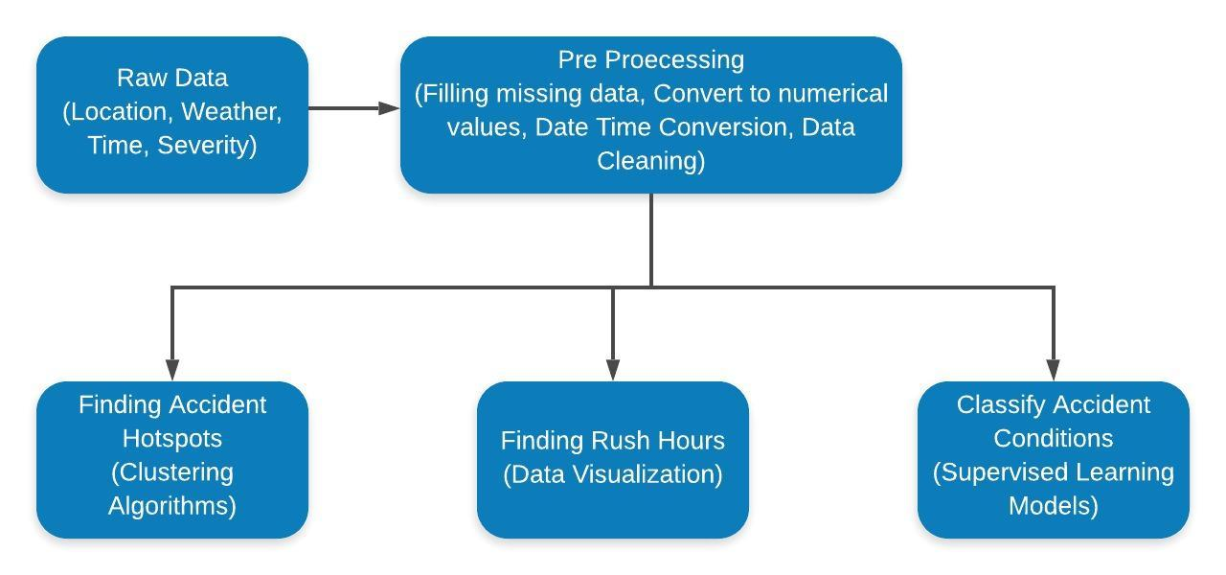
Predictive Analysis on Road Accident Based on Heterogeneous Sparse Data
Proposed Framework

Slide 7
Predictive Analysis on Road Accident Based on Heterogeneous Sparse Data
Data Pre Processing:
Filling Missing Data:
Filling with the data mean data using binning if the range of the data is less else fill with the regression method, else drop the record.
Convert to Number:
Converting the categorical data into numerical data using label encoding or dummy coding.
Date Time Conversion:
Creating new columns day, month, year, hour, minute, second from the existing datetime data.
Data Cleaning;
Removal of the unwanted data i.e. the attribute values not necessary for our study.

Slide 8
Predictive Analysis on Road Accident Based on Heterogeneous Sparse Data
Methodologies Used:
Finding Accident Hotspots: Finding the most accident prone areas i.e. identifying the areas with most severe accident records. For this we are using DBSCAN clustering algorithm.

Slide 9
Predictive Analysis on Road Accident Based on Heterogeneous Sparse Data
Finding rush hours: By seeing all the accident timings identifying the hours that are more prone to accident. From the data visualization we found the the hours of the day in which the accident occurs the most.
Classify the accident conditions: Depending upon the weather conditions and geographical location(latitude and longitude) classify the severity of the accident into 4 classes using supervised learning algorithm multilayer perceptron neural networks. Here we have used 3 fully connected network. Input layer, 1 hidden layer and output layer. For optimizing we are using SGD(stochastic gradient descent) optimizer and training the model for 10 epochs.

Slide 10
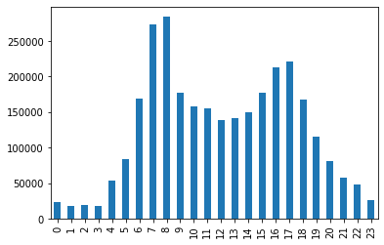
Results:
Rush hour Prediction:
So from here we can see that most of the accidents occur in between 7 am to 9 am in the morning and 4pm to 6pm in the evening
Predictive Analysis on Road Accident Based on Heterogeneous Sparse Data

Slide 11
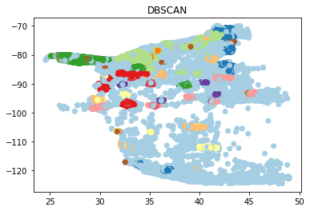
Accident Hotspot Prediction:
This accident hotspots are generated in the picture based on the road conditions. The various colors show different clusters having same densities based on road conditions.
Predictive Analysis on Road Accident Based on Heterogeneous Sparse Data

Slide 12
Predictive Analysis on Road Accident Based on Heterogeneous Sparse Data
Accident Severity Index Prediction using Supervised Learning:
In this we are getting almost 68% accuracy on predicting the severity of the accident based on the various weather conditions. So the model is giving good prediction.

Slide 13
Predictive Analysis on Road Accident Based on Heterogeneous Sparse Data
Conclusion:
So, we can conclude that the rush hours are the office times when the traffics on the road are maximum. The Hotspots are the places where the public service sectors like railway station and airports are nearby. Also, the severity classification deep learning model is working good with a good accuracy. So, by our work we can predict whether there will be an accident or not and if the accident occurs how much sever it may be. So necessary measures should be taken to prevent these accidents.

Slide 14
Predictive Analysis on Road Accident Based on Heterogeneous Sparse Data
THANK YOU

